Slide 1



Gang School Safety Team
A Joint Agency Based Intervention Strategy
Chicago Police Department
Gang Enforcement Division
Office of the Chief Judge - Cook County Juvenile Probation
Juvenile Justice Division
Chicago Public Schools
Office of School Safety and Security
Sgt. Kenneth Boudreau
Bureau of Organized Crime
Gang Enforcement Division
Notes:
Street gangs in the City of Chicago are described as a group of individuals who may or may not claim control over a certain territory in the community and engage, either individually or collectively, in violent or other forms of illegal behavior. However, one of the simplest and most functional definitions is that a gang is a group of people who form an allegiance for a common purpose and engage in violent, unlawful, or criminal activityGangs always have a name, they claim a particular territory or neighborhood, and usually direct its criminal activity towards rival gangs and the general population in the form of robberies, assaults and narcotics sales. Gang members participate in a variety of anti-social behaviors, including battery, mayhem, sexual assault, damage to property, larceny, murder, gang wars and other criminal activity.RolesGang members do not fit the movie image in which they are portrayed, fulfilling specific roles in the gang such as president or enforcer, and wearing gang jackets. Rather, leadership roles in street gangs are normally not formally recognized positions. Roles within the gang are usually assumed by a member who demonstrates or asserts dominant control at a particular incident, or for a limited time thereafter. Regarding smaller gangs, however, it is more likely that a single individual will become a recognized leader. Within the ranks of gang members, there are individuals who run the gamut from pranksters, to vandals, to armed robbers, to murderers!ViolenceGangs have also become more violent. Anybody in the area is fair game, including men, women and children. Previously, victims of gang violence were rival gang members, now they are often innocent bystanders killed or injured by stray bullets. In reality, certain gang-infested neighborhoods are frighteningly similar to a war zone. At one time, gang members used chains, knives and an occasional homemade "zip gun" when exhibiting violent behavior, now they use shotguns, automatic rifles, handguns and explosives. It is a lamentable fact that in our society, there is such a readily available supply of firearms. This fact, coupled with the availability of drugs and alcohol, leads to much of the impulsive violence that occurs in gang territories. MotivationGangs exist in almost every urban area, and until recently, have even become known in rural areas as well. They number well over a quarter million individuals throughout the country. They often form along ethnic and racial lines, although there is an increasing trend of young people joining gangs for economic motives.Gang CultureGangs also differ sub-culturally in their behavior. For example, homicides among Latino gangs are often ritual exhibitions of manhood, where in contrast, African American gangs typically fight over drug trade transactions, pay-offs, un-met expectations and similar "business" disappointments. Asian gangs’ crimes are notorious for extortion and home invasion robberies.Gang NamesMany gangs adopt names that have significance when related to their neighborhoods (street names, hills, valleys, housing projects, and occasionally regional names). Some gangs are generally further divided into factions or cliques. A gang faction will usually have its own name. Once in a particular faction, the member will remain in that faction throughout his gang career. The faction may change or alter its name as it matures, but the same individuals tend to remain in close association with each other.Member NicknamesIf they do not have one already, most gang members adopt nicknames when recruited into the group. The gang tends to select a name that fits the individual’s physical or psychological characteristics. A gang member called "Slice," for example, may get his name from his skill in handling a knife, or the nickname “shorty” because he’s short in stature.

Slide 2
KEY CONCEPTS
Intelligence Led Policing- originally articulated as a law enforcement operational strategy that sought to reduce crime through the combined use of crime analysis and criminal intelligence in order to determine crime reduction tactics that concentrate on the enforcement and prevention of criminal offender activity, with a focus on active and recidivist offenders , {Ratcliffe, JH (2008) }
Evidence Based Policing is a style of policing that uses research to create or change policies to increase effectiveness {Sherman , L (1998)}
- Small Group Dynamics {Lewin ,K (1943)}
- Cycle of Violence

Slide 3
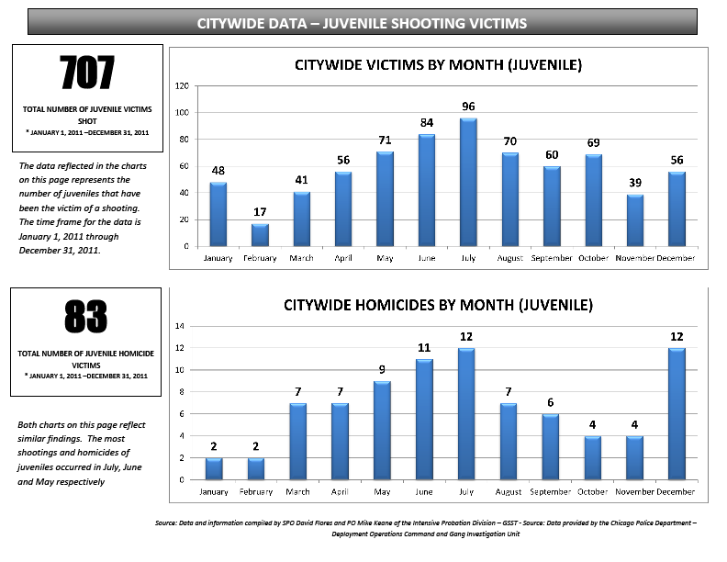
Current Trends
Gang Alliances trending toward spatial alliance
Warfare based on Childhood and High School Friendships
SOCIAL MEDIA

Slide 4
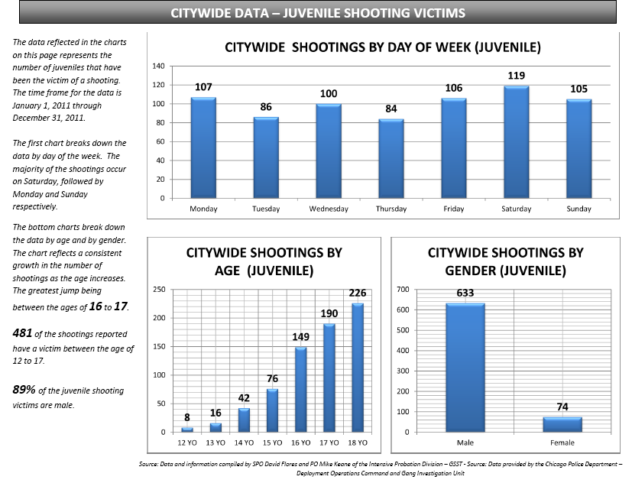

Slide 5
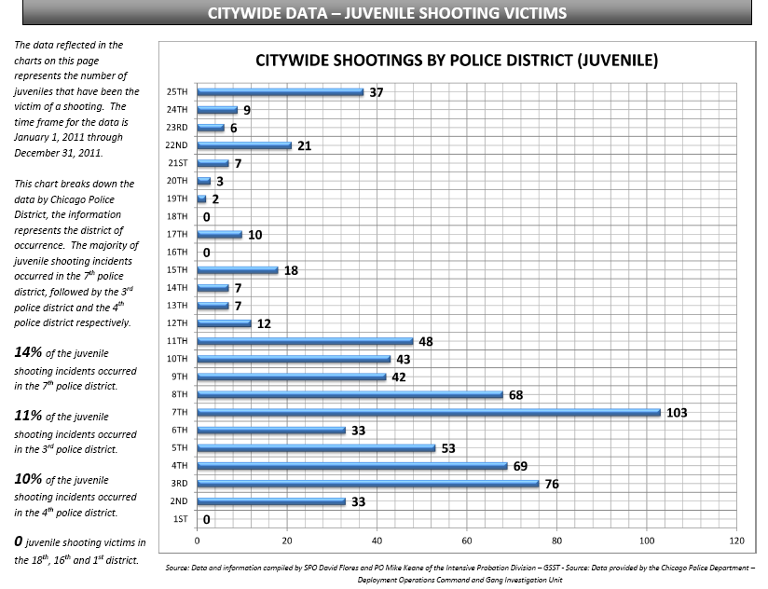

Slide 6
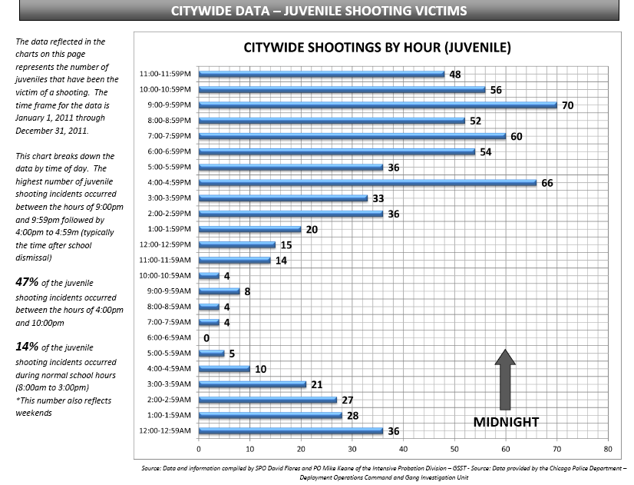

Slide 7
Chicago Public Schools
Elementary: 482 + 42 Charter
Total : 524
High schools: 122 + 29 Charter
Total : 151
Student Population:
- High School- 115,770
- Elementary- 239, 507

Slide 8

KEY COMPONENTS
Trigger Event-Shooting
Identification of victim-immediate by Responding Officers
Notification to Principal
GSST Responds to
School
Notification to Chicago Police
Crime Prevention and
Information Center
CPS Staff Identifies victims/associates/famil members plus offending group(s)
Victims school
Notification to Office of Student Safety and Security
Notification to CPD/CCJPD Gang Enforcement- GSST
Joint Intervention
Sessions Conducted
Completed within 24 hours

Slide 9
KEY COMPONENTS
Trigger Event-Shooting
Joint Intervention
Sessions Conducted
Assigned Probation Officer has 24 hours t Complete Report W/recommendations
Notification and Copy of Intervention Report to Cook County Juvenile Justice Division
Remedies/ Treatment
Written Notification to Assigned Probation -Chain
Written Notification to Assigned Judge
Completed within 48 hours

Slide 10
KEY COMPONENTS
Joint Intervention Sessions Conducted (GSST, CCJPD, CPS)
- Source of Conflict
Likely offending group
Likely retaliatory group
Likely geographic location
CPIC
Deployment
District Law Enforcement
Assets
OSSS
Climate Teams
Principal In house Security/Safe Passage
Immediate Violence Reduction Assessment
Student Needs Assessment
- Student Safety Plan
- Relocation
- Referral to Social Service
Agency
OSSS
Principal
YAP
Sister Referral Agency
Probation (adjust treatment)

Slide 11
Key Stakeholders and Participants
Students
Parents
CPS Staff
Police
Cook County Probation
Community Groups
Faith Based Organizations

Slide 12
Participants of Intervention
Identified Student
CPS Staff Representative -usually Dean, Asst. Principal or Principal
Gang Officer
Parent and or Mentor if time permits
Probation Officer if on Probation

Slide 13
Conduct of the Intervention
Location
Private
Away from view/knowledge of student population
CPS identifies AND pulls student never the police
These are not non-custodial interrogations. Officers are not there to investigate shooting, If student reveals he/she is eye witness , circ witness or 3rd party BOD is notified-intervention terminated.

Slide 14
Conduct of the Individual Intervention
Introduction--- Purpose
Informal
Candid Discussion about students exposure to violence and its impact
Students fears
Engage student in problem solving
Address cognitive dissonance-
Tree of support
Engage Motivational enhancement techniques
Their goals and a map of how to get them
Do not discuss actual incident rather cause and solution
WRAP AROUND STRATEGY

Slide 15
Conduct of the Group Intervention-Same Gang
CPS identifies all victim associates emphasis on likely students who will engage in retaliation
Prearranged with parent notification and presence
State the Problem- give group overview and purpose of meeting and consequences of continued activity
Encourage Parents and engage-- express their fears and hopes
Engage all in problem solving

Slide 16
To Be Effective
Must know history of gang and violence
Must know gang membership and hierarchy
Must know gang territories
Must know gang(s) activities
Must know gang monikers' and graffiti
Must know gang conflicts
Anniversary dates of victims
Avoid judgment(s)
Must know Disturbances/fights in school
Routes of students
Conflicts to and from school
Students family/siblings involvement in gangs if any
SOCIAL MEDIA

Slide 17
OUR NEW CI- FACEBOOK- YOU TUBE
Identify Criminal Association- What Gang
Identify Members
Identify Associates
Identify Alliances
Identify Rivals and Emerging Conflict
Identify Gang Boundaries or Locations
Identify Nicknames
Identify Stature in Gang
Identify Gang Monikers, Hand Signs, Graffiti
Monitor Gang Events and Parties
Identify Witnesses to an Incident

Slide 18
HOW CAN WE USE IT
Officer Safety- First and Foremost
Identify likely Shooter’s
Additional Information for Title III, Pen Register etc.
Search Warrant
Documentary Search Warrant
Establishing Motive
GREAT FOR SENTENCING HEARING

Slide 19
HOW CAN WE USE IT
Deployment Strategies
Predictor of Future Violence
Linking of Violence
Violating Terms of Parole and or Probation OR Extending Terms
Identifying EMAIL Accounts,, Cellular Telephone Numbers, PayPal Accounts

Slide 20
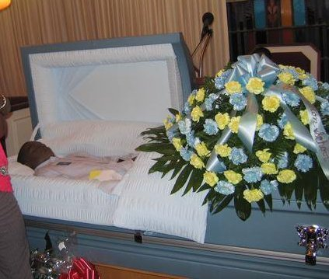
Case Study-TOOKA
Homicide of "S.T.L." member:
12-JAN-11 602 E. 63rd St. HT116872
Victim: Last Name -GREGORY, Shondale AKA “Tooka”
FB name Fitchmade Ohsixthreesaluteorshoot Fuqboy
Gang Affiliation: St Lawrence (STL)
Homicide of Phillips H.S. student,

Slide 21
FACEBOOK and YOU TUBE YIELDED THE FOLLOWING
Ongoing Violent Conflict
Gang Alliances
Gang Boundaries
Gang Members
Likely Shooters
Gang antagonizing to exacerbate conflict

Slide 22
Below is an example of a Facebook page in which the user of the FB page was the victim of a homicide in January 2011.
Prior to Shondale Gregory's (AKA Tooka) homicide, comments are posted on victim's page identifying victim's gang association to be St. Lawrence Boys and rival gang also identified on victim's page as Young Money. Three days prior to victim's homicide victim posted derogatory comments regarding deceased leader of the Young Money Gang, Eddrick Walker (AKA TY) on his page.
Facebook posts of homicide victim, Shondale Gregory, 3 days prior to his homicide
Fitchmade Ohsixthreesaluteorshoot Fuqboy posts
Man muthafckas need 2 keep our name out dey mouth....muthafuckas shouldnt be lackn...KEEP MA TEAM NAME OUT YALL MOUTH WE S.T.L....BANG BANG BITCH...
January 9 at 11:03am via Mobile Web
Robin Petties posts
yhu s.t.l wowww, s.t.l k...wat who mad
January 9 at 11:19am via Facebook Mobile
Fitchmade Ohsixthreesaluteorshoot Fuqboy posts
‎@keya im finna call yhu....ROBIN BITCH WATCH UR MOUTH YHU ASKN WHO MAD BITCH YHU MAD...S.T.L TILL DHA DEATH OF MEH BANG BANG BITCH
January 9 at 11:53am via Facebook Mobile ·
Robin Petties posts
tooka stop playn with meh wit yo goofey ass,young money till dha world end fuck...bitch
January 9 at 12:03pm via Facebook Mobile
Keya Cash'out Ghurl posts
‎-@Tooka Kall Meh Back Tooka Hunz We Dnt Beat Dha Keyboard Or Sympathizee Fah Silly Kids Kut Dhat Shyt Out
January 9 at 12:09pm via Facebook Mobile ·
Fitchmade Ohsixthreesaluteorshoot Fuqboy posts
ROBIN YHU SCARY AS HELL...BITCH S.T.L,E.B.T,A.B.M,JARO CITY IN DHAT ORDER WE GOT SHOOTERS ON DECK ASK T.Y

Slide 23
ROBIN YHU SCARY AS HELL...BITCH S.T.L,E.B.T,A.B.M,JARO CITY IN DHAT ORDER WE GOT SHOOTERS ON DECK ASK T.Y
Post reveals Gang Alliance
STL= Saint Lawrence Boys
EBT= Everything But Trap
ABM= All About Money
Jaro City= Gang area named after homicide victim
TY Homicide Victim of Opposing Gang Eddrick Walker- Prince of Cottage Grove 21MAY09

Slide 24
Analysis of Related Posts yield Intelligence Product
Gang Boundaries
Gang Alliances
Related Shootings
Gang Provocation
Likely Shooters

Slide 25
Intelligence Product
1. REPORTED BY: P.O. Almanza, T. #10289 P.O. Fuentes E. #11862 | 2. CROSS RELATED FILE FILES 1. EBERHART BOYS (EBT) 2. ST. LAWRENCE BOYS (STL) 3. CASH OUT BOYS (COB) 4. POCKET TOWN BPSN 5. CRANKTOWN BPSN 6. CHIEF TOWN/GROVE PARK ALL ABOUT MONEY (ABM) 7.KILLA WARD (006th District) Vs. 9.DRO CITY 10.YOUNG MONEY 11.ROCK CREEK 12. LAMRON (006th District) 13. WIIC CITY/KETA WORLD 14. ROW LIFE/GD's 15. TRAP CITY 16. 66-67 Chris World Crazy | 3. File No.: G003-0308 G003-0309 G003-0304 G006-0302
4. Date Prepared: 27 APRIL 2011 |  | 5. File Title:
6. Other Officers: P.O. C. Beluso # 8845 Sgt Boudreau #852 7. C.P.S. High Schools: Hyde Park H.S. Emmett Till Elementary School 6220 S. Stony Island/Bt. 314 6543 S. Champlain/Bt. 312

Slide 26

Gang Provocation/Alliances

Slide 27
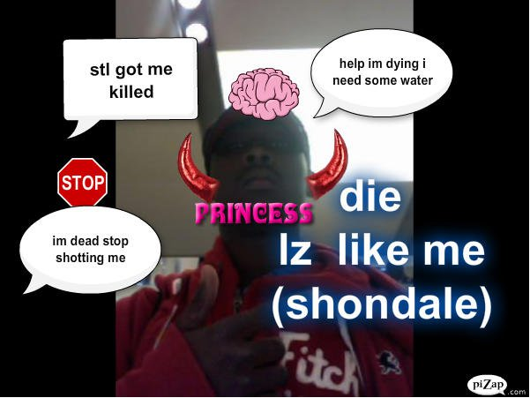
Gang Provocation

Slide 28

Gang Provocation

Slide 29
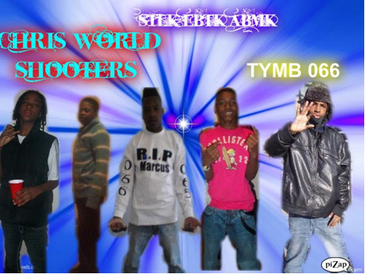
Likely Shooters

Slide 30
WHAT YOU CAN EXPECT
Intervention Report
NOTE: Student Perceptions drive Violence
Gangs Involved
Area of Retaliation
Offending Gang
Social Media Intelligence
EMAIL Notification of Gang Parties and Events

Slide 31
JOINT COMSTAT MEETINGS
CPD/CPS- held once a month
Usually three- four Schools
CPS- Questions Principals
CPD Questions Commanders and School Sergeants
- Gangs Present in School or affecting School
- Students Shot
- Gang Altercations in School
- Corridors of Passage

Slide 32
Thank You

